Slide 1
Software Engineering CS20006
Lecture 18
Design Analysis

Slide 2
System Design Analysis

Slide 3
Lecture #18
Design review
Significance of design review
Tasks of design reviewers
Team for reviewing a design
Criteria for a “good” system design
Achieving a “good” design
Modularity
Clean decomposition
Coupling
Cohesion
Neat arrangement

Slide 4
Design Review
System design deals with transforming the customer requirements (as described in the SRS document) into a form that can be implemented using a programming language
After a design is complete, the design is required to be reviewed
Items to be reviewed are:
Traceability
Whether each functional requirement in the SRS document can be traced to some bubble in the DFD model and vice-versa
Whether each bubble of the DFD can be traced to some module in the structure chart and vice-versa

Slide 5
Design Review
Correctness
Whether the data structures of the detailed design are correct or not
Different modules required to implement the design solution are traced out or not
Implementation
Suitable algorithm is possible with the proposed data structures or not
Whether the design can be easily implemented (minimum coding overhead)
Whether design can be efficiently implemented (minimum hardware, minimum memory usage and faster execution time)
Maintainability
To check whether the design can be easily maintained in future or not

Slide 6
Design Review Team
The review team usually consists of members with
The system analysts (who have designed the system)
Implementation team (who would code the design)
Testing team (who would test the implementation)
Maintenance team (who deal with the customer and after sale support)

Slide 7
Criteria for a “Good System Design”
Very difficult to decide criteria for a “good” design
Goodness of design varies from system to system
Real-time system
Where the speed is the main target
Design with lower memory requirement (at the cost of speed) is a bad design
Embedded system
Where the memory is the main constraint
Design with larger memory requirement is a bad design

Slide 8
Criteria for a “Good System Design”
System designers rely on few desirable characteristics
Correctness
A good design should correctly implement all the functionalities of the system
Understandability
A good design should be easily understandable
Efficiency
It should be efficient
Maintainability
Is should be easily amenable to change

Slide 9
Good System Design-Correctness!
Most preferable goodness criterion is the design correctness
If the design is not correct it is nothing worth at all!

Slide 10
Good System Design-Understandability!
The next most important goodness criterion is the understandability
A design is easy to understand automatically implies
Easy to implement
Easy to test
Easy to maintain

Slide 11
Achieving a “Good” Design
For a “good” design focus on
Modularity
Clean decomposition
Neat arrangement

Slide 12
Why Modularity?
Divide and conquer is the best policy to accomplish any goal
Decomposition of a problem into modules facilitates the design by taking advantage of the divide and conquer principle
Modular design provides
Smaller things is easy to understand than the bigger one
Reduces the complexity of the design solution greatly
Improves the code reusability
A good modular design is desirable

Slide 13
How a Design with Good Modularity?
Key to any good modular design
Functional independency
A functional independent module has minimal interaction with other modules
Advantages
Error isolation >> Reduce error propagation
Better code reusability
Understandability
Clean decomposition >> To achieve functional independency
Neat arrangement >> To ensure better modular organization

Slide 14
Clean Decomposition
Two factors deciding the clean decomposition
Coupling
The coupling between two modules indicates the degree of interdependence between them
One way to measure the design quality is coupling
Our objective is to minimize the coupling (i.e. to make module as independent as possible)
Low-coupling between modules indicates a well-designed system
Cohesion
The cohesion is a measure of the functional strength of a module
More cohesive module performs a single task or function
A module is more cohesive means it is more functionally independent
A functionally independent module has minimal interaction with other modules

Slide 15
Classification of Coupling
The degree of coupling between two modules depends on their interface complexity
There are different types of coupling exist between different modules
Classification of different types of coupling helps us to quantitatively estimate the degree of coupling between the modules
Five types of coupling can occur between any two modules
Data coupling
Stamp coupling
Control coupling
Common coupling
Content coupling

Slide 16
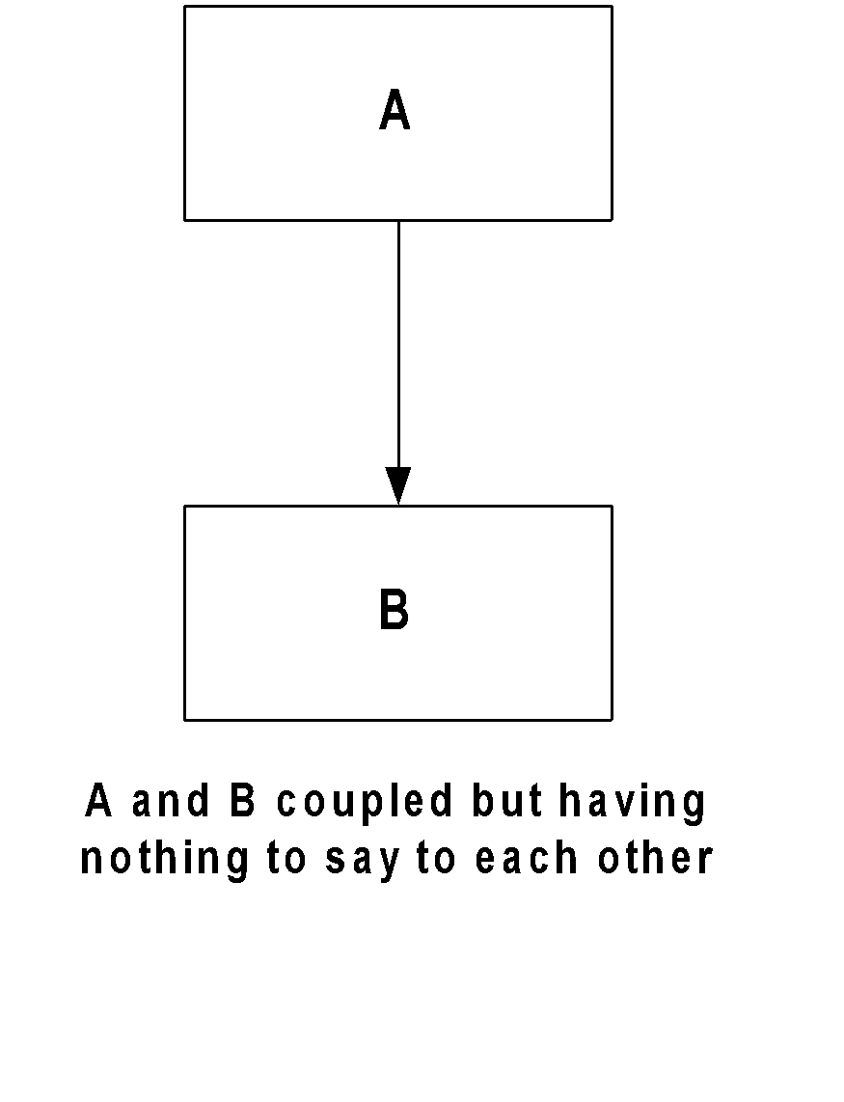
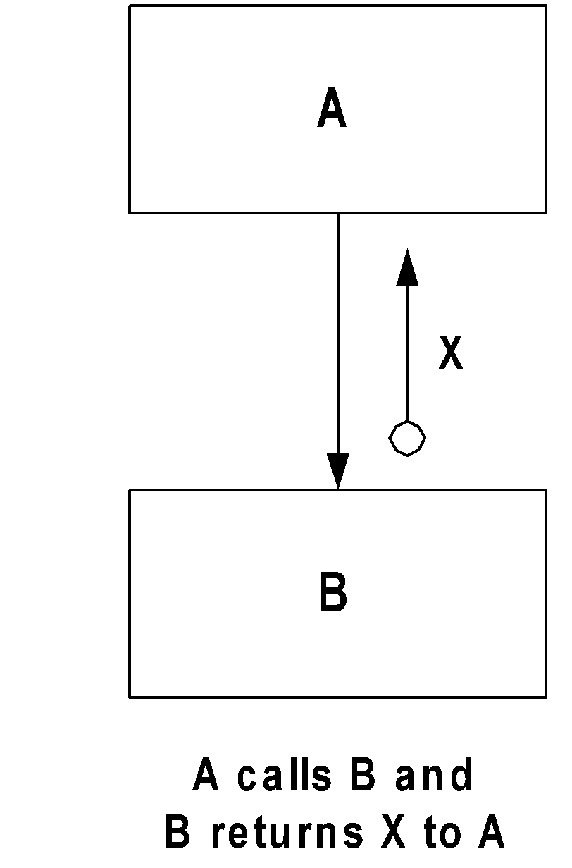
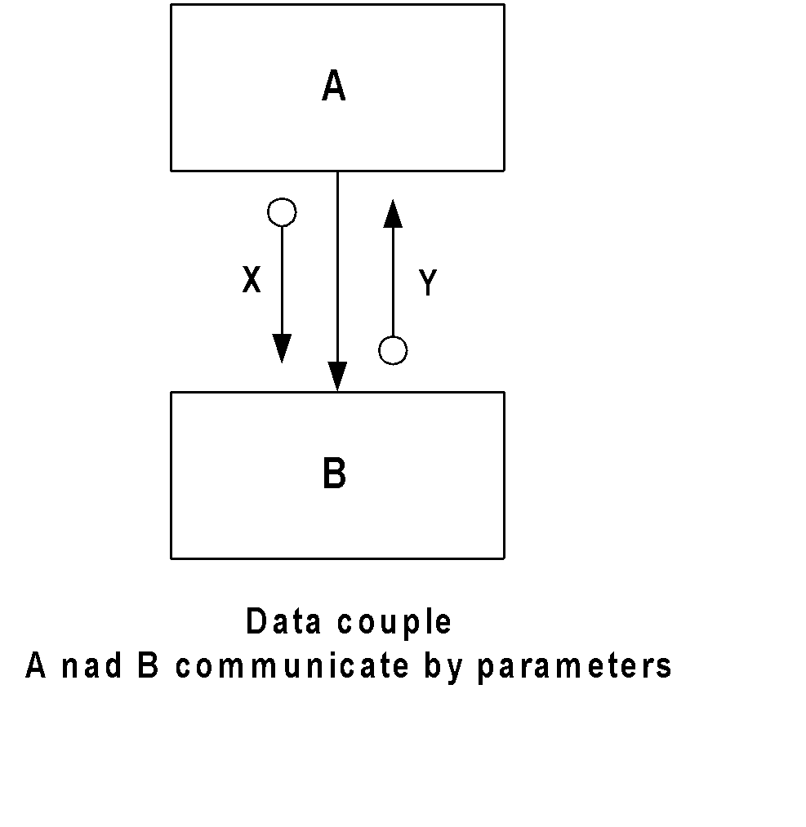
Data Coupling
Two modules A and B, are normally coupled if
A calls B
B returns to A
All information passed between them is by means of parameters presented with the call itself

Slide 17
Data Coupling
For a good design with data coupling the following points should be noted:
Two modules must communicate by means of passing parameters
We must keep the number of paramours as small as possible. Nothing more or nothing less!
We should avoid tramp data which travel aimlessly around a system

Slide 18
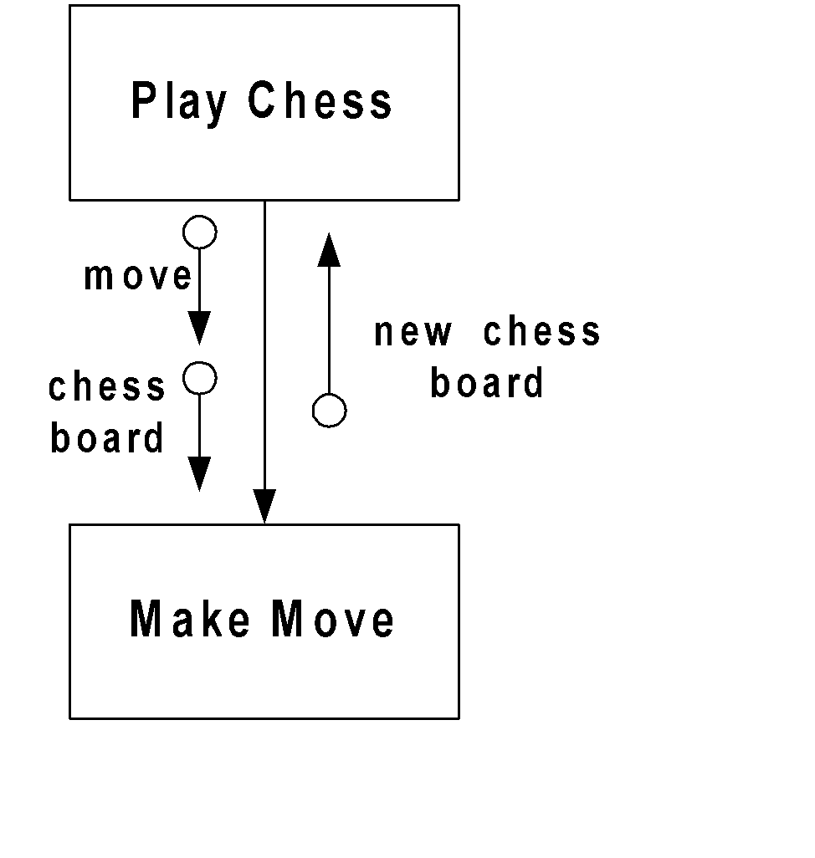
Stamp Coupling
Two modules are stamp coupled if one passes to the other a composite piece of data (i.e. a piece of data with meaningful internal structures)

Slide 19
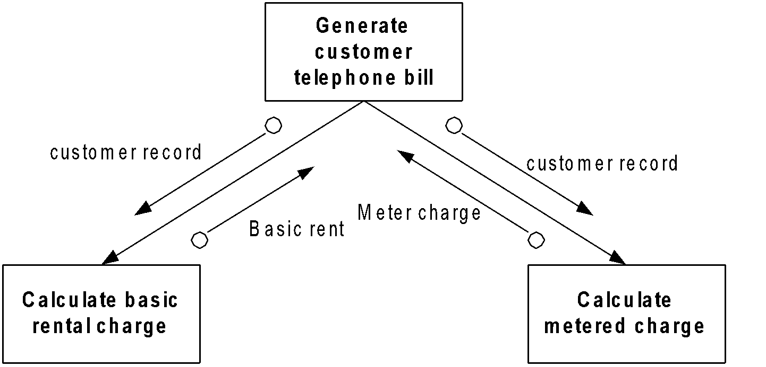
Stamp Coupling
Points to be noted
Never pass records containing many fields to modules that need only one or two of these fields
A change in the format of a field in the record requires changes in all modules receiving the record. In other words, we create unnecessary dependency between modules

Slide 20
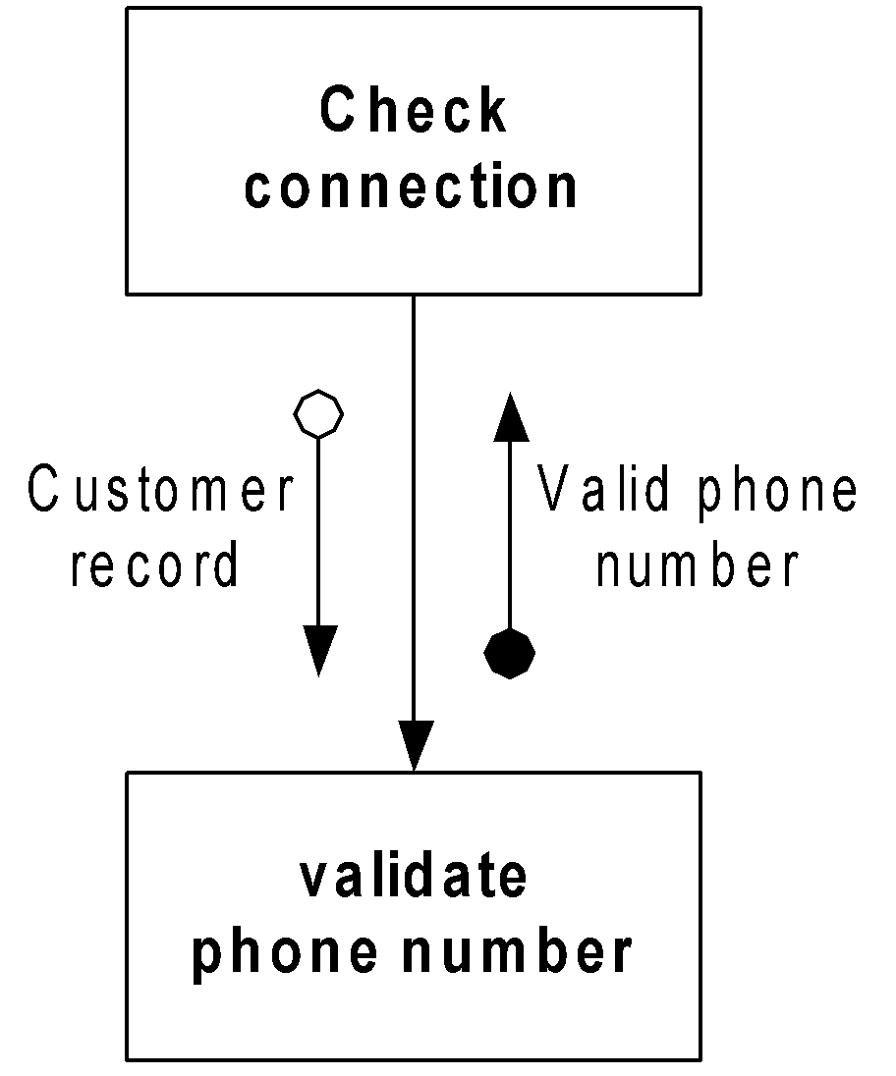
Stamp Coupling
Points to be noted
2. Unnecessary dependency hinders the reusability of modules as well as increases the risk of garaging other data field
Instead of sending the whole record, sending only the phone number be would better to provide functional independency

Slide 21
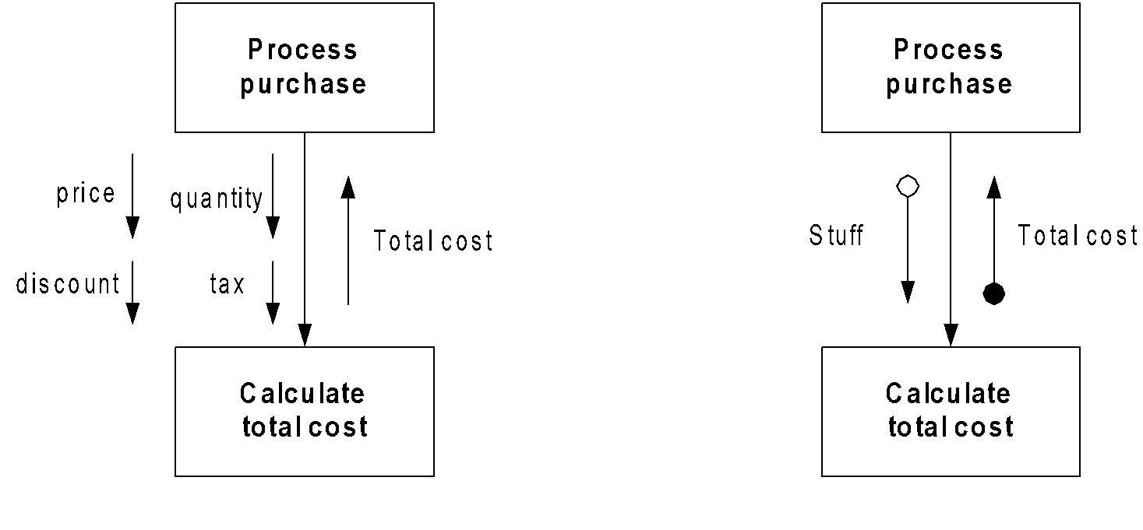
Stamp Coupling
Points to be noted
3. We should not create an artificial data structure to bundle a number of data fields.
This approach may appear to reduce coupling. However, this does nothing but hide the problems and hence reduces the understandability

Slide 22
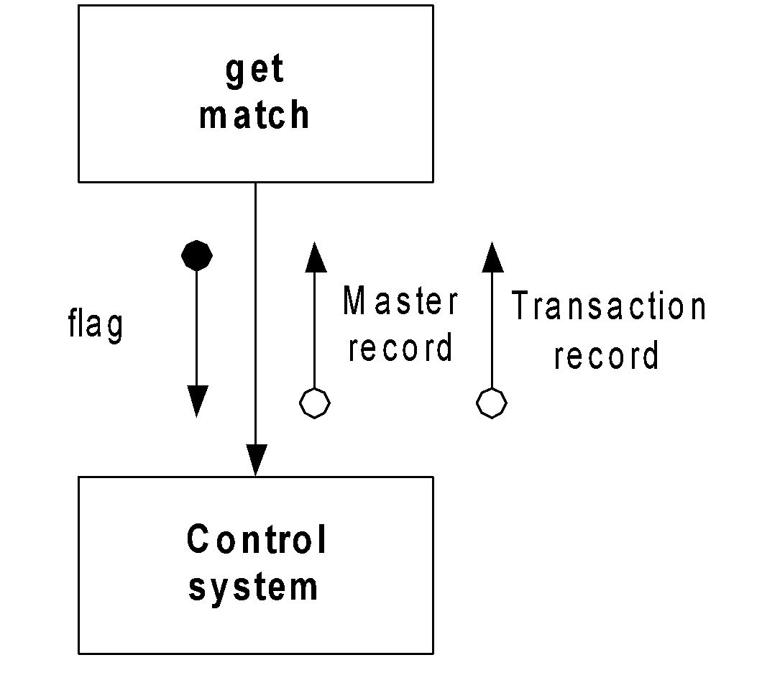
Control Coupling
Two modules are controlled couple if data from one module is used to direct the order of instruction execution in another
Example
The value of flag
1. get the next master record
2. get the next transaction record
3. get both
4. default is nothing
If a control flag passes downward then caller must know the internals of its called
If the control flag heads upward from a called to a caller then the called must know the caller’s internal

Slide 23
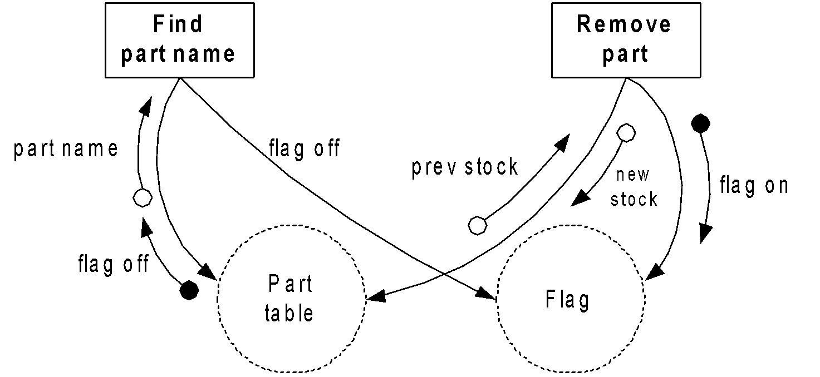
Common Coupling
Two modules are common coupled if they refer to the same global data area

Slide 24
Common Coupling
Common coupling is bad for many reasons
Modules that refer to a global data usually do so by explicit name (poor readability)
It introduces remoteness into system. It takes a long time to understand which module has changed the value of a global data when it was done (poor understandability)
Global data may sometimes be drastically abused. Different modules may use the same data for different purpose (poor guarantee)
It is difficult to discover what data must be changed if a module is changed. It is also difficult to find out what modules must be changed if a global data is changed (poor maintainability)
The use of common data degrades the idea of modularity by allowing data to stay outside

Slide 25
Content Coupling
Two modules exhibit content coupling if one refers to the inside of the other in any way
e.g. a branch from one module to another
Content couple straightway defies the principal of modularity
Common coupling and content coupling are the two coupling against the good modularity and should be avoided under any situation

Slide 26
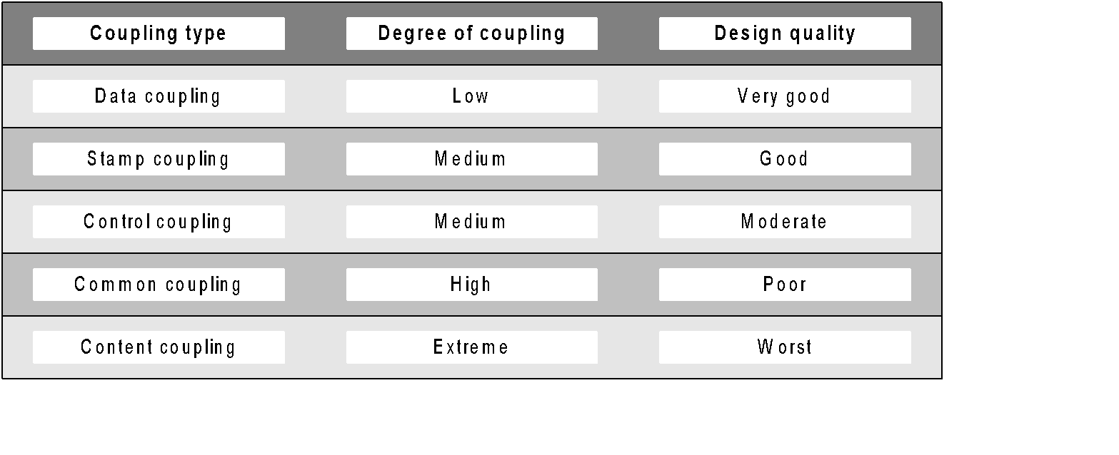
Rank of Couplings

Slide 27
Determining Coupling Type
Two modules may contain more than one coupling at a time
There coupling will be defined by the worst coupling type
Example
If two modules are stamp and common coupled, then they are actually common coupled

Slide 28
Low Coupling vs. High Coupling
Low coupling is preferable because
The fewer connections between two modules, the less chance there is for ripple effect (a defect in one module appearing as a symptom in another)
It is easier to change one module with minimum risk of having to change another or even the change with minimum side effect
While maintaining a module it is not necessary to be concerned about the internal details of any other modules
High coupling is not preferable because
Makes a design difficult to understand and maintain
Increases development effort as the modules having high coupling cannot be developed independently by different team members
Modules having high coupling are difficult to implement and debug

Slide 29
Classification of Cohesions
Cohesion implies how the activities within a single module are related to one another
e.g. merge sort 🡪 partition + merging
e.g. finding inverse of a matrix
Cohesion is the measure of the strength of functional relatedness of elements within a module. Elements means an instruction, a group of instructions or a call to another module
There are various types of cohesions:
Functional cohesion
Sequential cohesion
Communicational cohesion
Procedural cohesion
Temporal cohesion
Logical cohesion
Coincidental cohesion

Slide 30
Functional Cohesion
A functionally cohesive module contains elements that all contribute to the execution of one and only one problem related task
Theses modules have a strong and single-minded purpose
A functionally cohesive module can be described in a simple sentence
Example
Read customer record
Sort the list

Slide 31
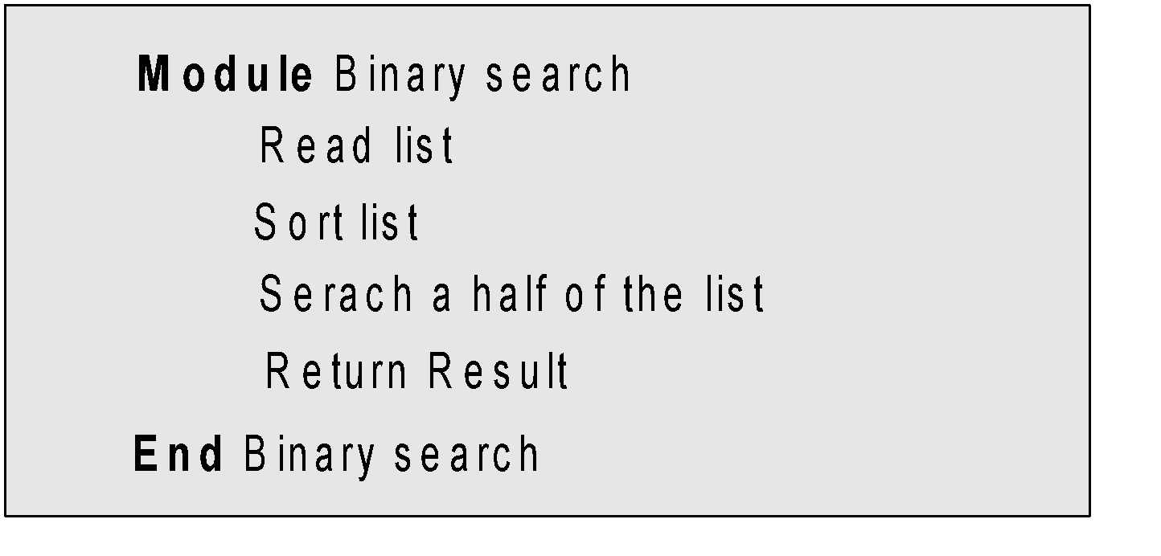
Sequential Cohesion
A sequentially cohesive module is one whose elements are involved in activities such that output from one activity add input data to the next
A sequentially cohesive module usually has good coupling and easily maintainable

Slide 32
Communicational Cohesion
A Communicational cohesive module is one whose elements contribute to activities that refer to or update the same data structure
Example : Given the Accession Number of a book
Find the title of the book
Find the price of the book
Find the name of the publisher
Find the author of the book
The four activities are related because they all work on the same input data

Slide 33
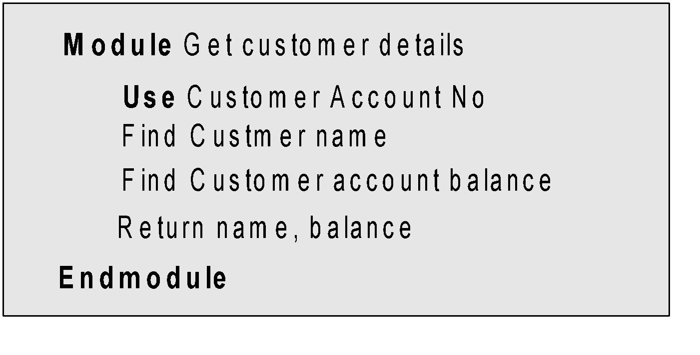
Communicational Cohesion
Another example of a communicational cohesive module is:
Communicational cohesive module are quite maintainable
Module that do not use Customer account balance may discard the data field return by the module

Slide 34
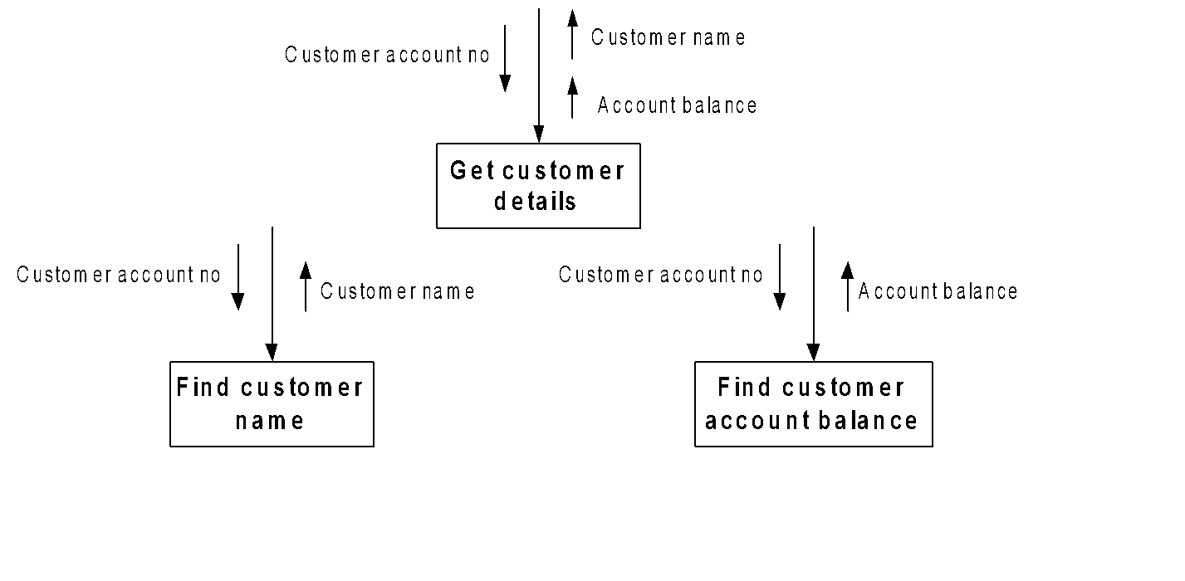
Communicational Cohesion
It is always better to improve maintainability if we split a communicational cohesive module into separate, functionally cohesive ones

Slide 35
Communicational Cohesion
Modules with communicational and sequential cohesion seem similar since they both contain activities organized around the data in the original problem
The main difference between them is that in a sequentially cohesive module, individual activities must be carried out in a specific order. Whereas, in a communicational cohesive module, order of execution is not important

Slide 36
Procedural Cohesion
A procedural cohesive module is one whose elements are involved in different and possibly unrelated activities in which control flows from one activity to another
(Note: In sequential cohesive module data flows from one activity to another)
Activities in a procedurally cohesive modules are related by order of executions
Procedurally cohesive modules tend to be composed of pieces of functions that have little relationship to one another

Slide 37
Temporal Cohesion
A temporal cohesive module is one whose elements are involved in activities that are related in same time span
Example
The set of functions responsible for initialization, start-up, shut-down of some process etc. are the classic examples
Unlike procedural cohesive modules, temporal cohesive modules are tend to be composed of partial functions whose only relationship to one another is that they all happen to be carried out at a certain time
The order of execution of activities is more important in procedurally cohesive modules. Also procedural cohesive modules tends to use loops and decision between functions, whereas temporal modules tend to contain more straight line code
In temporal cohesive modules activities are related to time and hence the module is difficult to reuse

Slide 38
Logical Cohesion
A logically cohesive module is one whose elements contribute to activities of the same general category (such as data input, data output, error message etc.) in which the activities to be executed are selected from outside the module
Example
A set of print functions generating different output reports are arranged into a single module

Slide 39
Coincidental Cohesion
A coincidental cohesive module is one whose elements contribute to activities with no meaningful relationship to one another
In a coincidental cohesive model, the module contains a random collection of functions (without any though or decision rather pure coincidence)
Such a module is theoretically possible, rarely known in any practical application

Slide 40
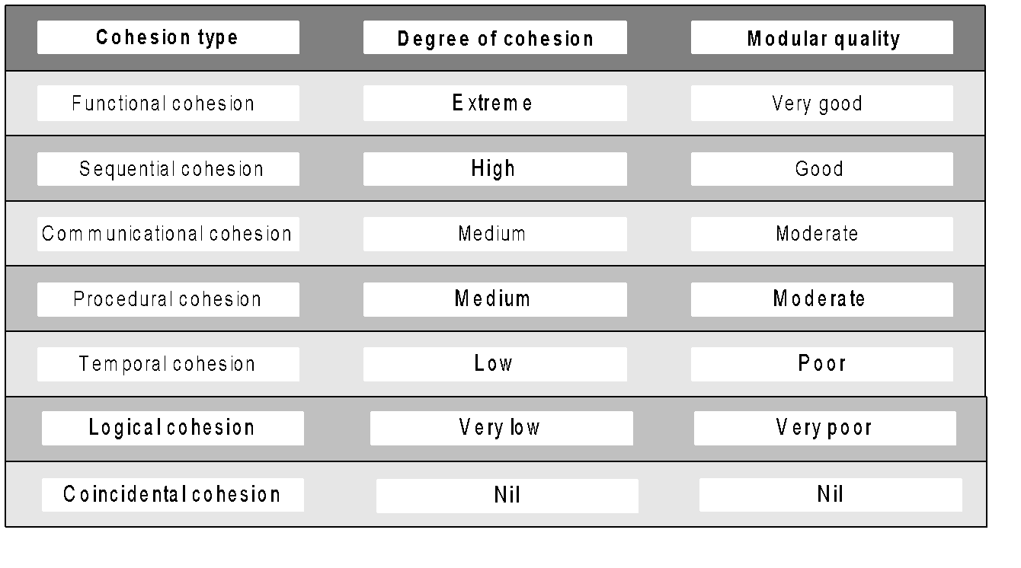
Ranking of Cohesions

Slide 41
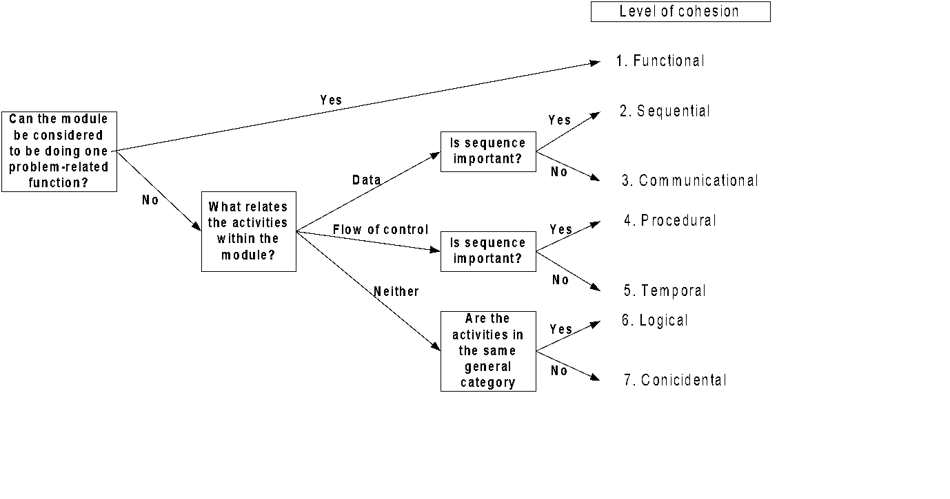
Deciding Module Cohesion

Slide 42
Coupling + Cohesion = Clean Decomposition
Coupling
Coupling is a way to measure design quality
Low coupling between modules indicates a well-partitioned system (or cleanly the modules are separated)
A good design should have minimal coupling
Cohesion
Cohesion is a way to measure how a module is truly a module
High cohesion means activities inside the module is very strongly related and not separable
A good module should have maximal cohesion

Slide 43
Neat Arrangement
A “good” design means it is a well structured design, which can be achieved with a neat arrangement of modules
Principles for neat arrangements are:
Layered architecture
Control abstraction
High fan-in
Low fan-out

Slide 44
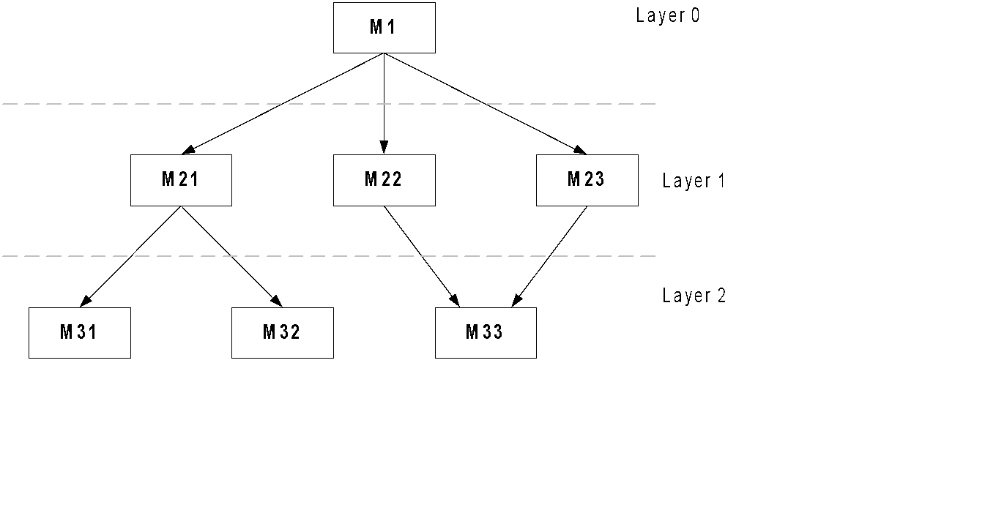
Layered Architecture
It provides a very sharp boss-subordinate relationship among modules
In a layered architecture, modules are arranged layer by layer

Slide 45
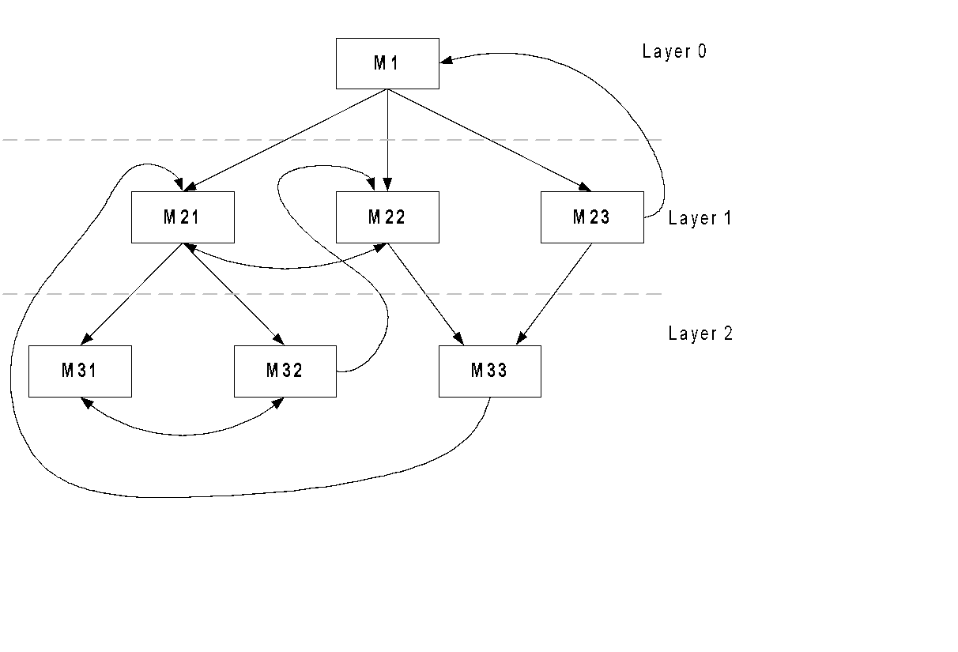
Control Abstraction
A module should invoke the function of the modules in the layer immediately
A module in the lower level should not invoke the services of the module (s) at its upper level (s)

Slide 46
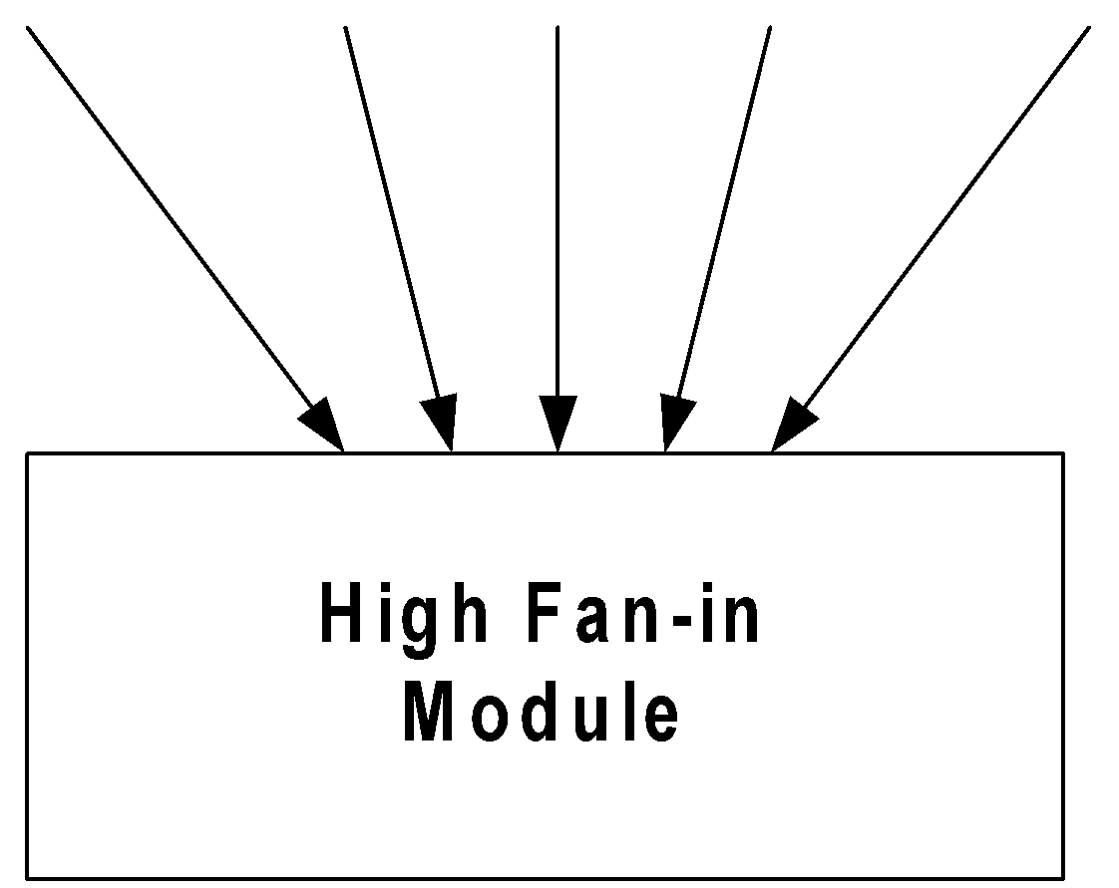
High Fan-in
Fan-in indicates the number of modules directly invoking a given module
High fan-in means more code reusability
A design with high fan-in is encouraged

Slide 47
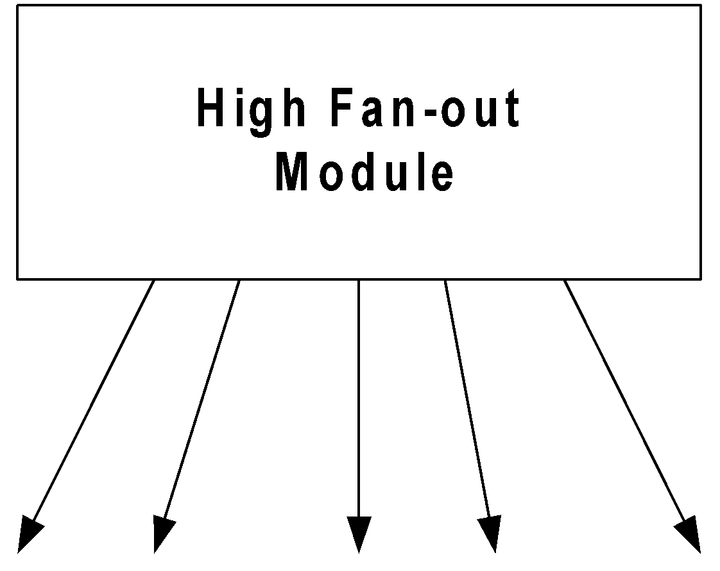
Low Fan-out
Fan-out of a module indicates the number of modules that are directly controlled by the module
A module with high fan-out means it is poor in cohesion
A “good” design prefers low fan-out modules

Slide 48
Problems to Ponder
How quantitatively we can measure the quality of a design?

